Slide 1
What is Data Sciences (Application:
Machine Learning)
Broadly, machine learning is the application of statistical, mathematical, and numerical techniques to derive some form of knowledge from data. This ‘knowledge’ may afford us some sort of summarization, visualization, grouping, or even predictive power over data sets.
With all that said, it’s important to emphasize the limitations of machine learning.
It is not nor will it ever be a replacement for critical thought and methodical, procedural work in data science. Indeed, machine learning can be reasonably characterized a loose collection of disciplines and tools.

Slide 2
Regression
A major component of machine learning (Data Science), the one that most people associate with ML, is dedicated to making predictions about a target given some inputs, such as predicting how much money an individual will earn in their lifetime given their demographic information.
In this part, one is going to focus on the case where its prediction is a continuous, real number.
When the target is a real number, one call this prediction procedure regression.

Slide 3
In order to understand regression, let’s start in a more natural place:
What types of problems are we trying to solve?
What exactly does it mean to make a prediction that is a continuous, real number?
To build some intuition, here are a few examples of problems that regression could be used for:
Predicting a person’s height given the height of their parents.
Predicting the amount of time someone will take to pay back a loan given their credit history.
Predicting what time a package will arrive given current weather and traffic conditions.
Given some inputs, one needs to produce a prediction for a continuous output.
That is exactly the purpose of regression.
Notice that regression isn’t any one technique in particular. It’s just a class of methods that helps us achieve our overall goal of predicting a continuous output.

Slide 4
Solution Options
List of regression techniques
K-Nearest-Neighbors (KNN)
K-Nearest-Neighbors is an extremely intuitive, non-parametric technique for regression or classification.
It works as follows in the regression case:
Identify the K points in our data set that are closest to the new data point. ‘Closest’ is some measure of distance, usually Euclidean.
Average the value of interest for those K data points.
Return that averaged value of interest: it is the prediction for our new data point.

Slide 5
Neural Networks
A neural network works by scaling and combining input variables many times. Furthermore, at each step of scaling and combining inputs, we typically apply some form of nonlinearity over our data values.
Random Forests
Random forests are what’s known as an ensemble method. This means we average the results of many smaller regressors known as decision trees to produce a prediction. These decision trees individually operate by partitioning our original data set with respect to the value of predictive interest using a subset of the features present in that data set.
Gradient Boosted Trees
Gradient boosted trees are another technique built on decision trees. Assume we start with a set of decision trees that together achieve a certain level of performance.
Turning to Linear Regression

Slide 6
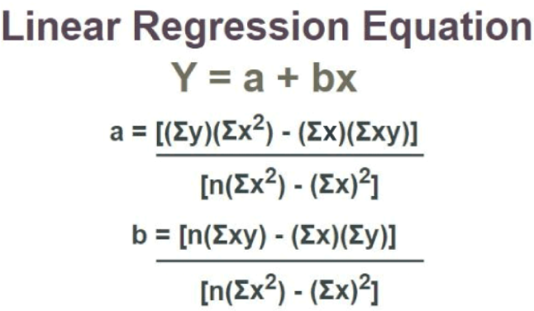
Linear Regression
Linear regression is a statistical method that is used in various machine learning models to predict the value of unknown data using other related data values. Linear regression is used to study the relationship between a dependent variable and an independent variable.

Slide 7
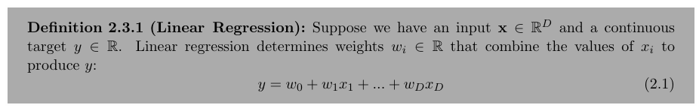
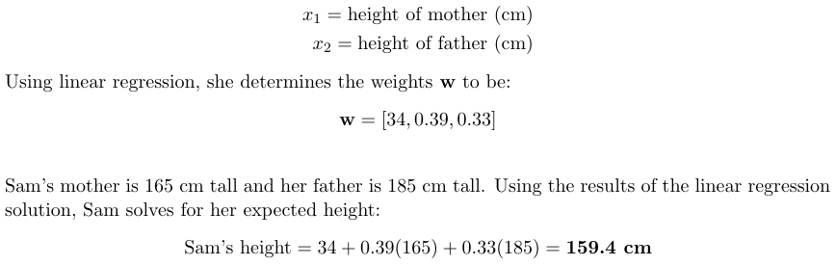
Let’s illustrate how linear regression works using an example, considering the case of 10 year old Sam. She is curious about how tall she will be when she grows up. She has a data set of parents’ heights and the final heights of their children. The inputs x are

Slide 8
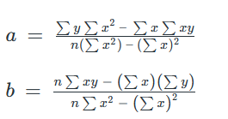
Linear Regression Equation
Linear regression line equation is written in the form:
y = a + bx
where,
→ x is Independent Variable, Plotted along X-axis
→ y is Dependent Variable, Plotted along Y-axis
The slope of the regression line is “b”, and the intercept value of regression line is “a”(the value of y when x = 0).
Linear Regression Formula
Formula used for linear regressions is, y = a + bx
Intercept value, a, and slope of the line, b, are evaluated using the formulas given below:
where,
y is Dependent Variable that Lies along Y-axis
a is Y-Intercept
b is Slope of regression line
x is Independent Variable that Lies along X-axis

Slide 9
Properties of Linear Regression
In the linear regression line if the regression parameters a₀ and a₁ are defined, the properties are given as below:
Linear regression line reduces the sum of squared differences between
observed values and predicted values.
Linear regression line always passes through the mean of X and Y variable
values.
Linear regression constant (b₀) is equal to the y-intercept of the linear
regression.
→ Linear regression coefficient (b₀) is the slope of the regression line.

Slide 10

What is Linear Regression Used for?
Various uses of Linear Regression are:
→ It is used in market research and
study of customer survey results.
→ It is used for studying
performance of engine of
automobiles.
→ It is used in deciding the effective
price of any goods.
→ It is used in astronomy.
Regression Coefficient
Linear regression line, equation:
Y = B₀ + B₁X
where,
B₀ is a Constant
B₁ is Regression Coefficient
Here, B₁ is the regression coefficient and its formula is,
where,
→ x_{i} and y_{i} are Observed Data Sets
→ x and y are Mean Value

Slide 11
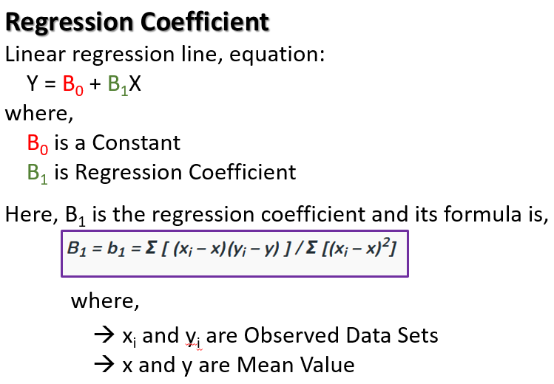
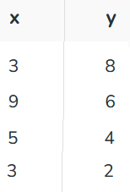
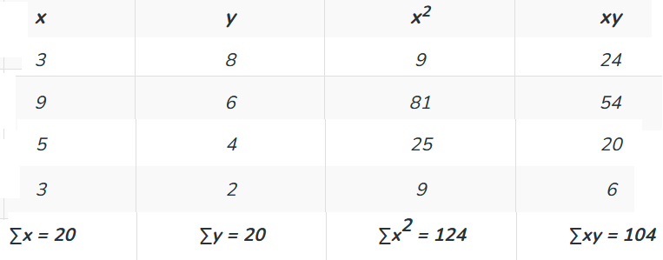
Question 1: Find the linear regression equation for the given data:
Calculating intercept and slope value.

Slide 12


Using formula for a,
a = {20 (124) – 20 (104)} / {4 (124) – 400}
a = 400/96 = 4.17
Using formula for b,
b = {4 (104) – 20 (20)} / {4 (124) – 400}
b = 16/96 = 0.166
So, linear regression equation is:
y=a+bx => y = 4.17 + 0.166x

Slide 13
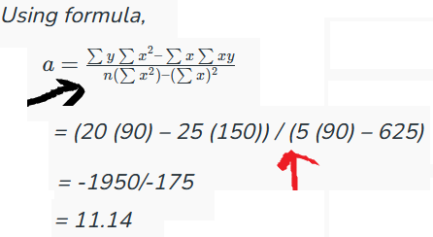
Find the intercept of linear regression line if ∑x = 25, ∑y = 20, ∑x² = 90, ∑xy = 150 and n = 5.
SLOPE??

Slide 14
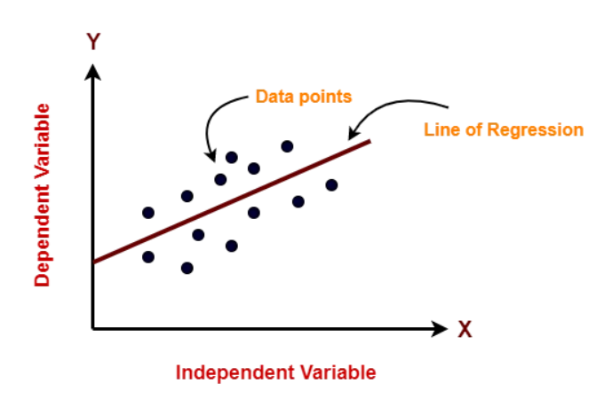
11/11/2024
The equation for a simple linear regression model can be written as follows:
y = b₀ + b₁ * x
Here, y is the dependent variable (the variable we are trying to predict), x is the independent variable (the predictor or feature).
b0 is the intercept term (the value of y when x is zero), and
b1 is the slope coefficient (the change in y for a unit change in x).
The goal of Linear Regression is to find the best values for b0 and b1 such that the line best fits the data points, minimizing the errors or the difference between the predicted values and the actual values.

Slide 15
Types of Linear Regression?
There are two main types of Linear Regression models:
-- Simple Linear Regression and
-- Multiple Linear Regression.
Simple Linear Regression: In simple linear regression, there is only one independent variable (also known as the predictor or feature) and one dependent variable (also known as the response variable). The goal of simple linear regression is to find the best-fitting line to describe the relationship between the independent and dependent variable. The equation for a simple linear regression model can be written as:
Y = b₀ + b₁ * X
Here, Y is the dependent variable, X is the independent variable, b0 is the intercept term, and b1 is the slope coefficient.

Slide 16
Multiple Linear Regression: In multiple linear regression, there are multiple independent variables and one dependent variable. The goal of multiple linear regression is to find the best-fitting line to describe the relationship between the independent variables and the dependent variable. The equation for a multiple linear regression model can be written as:
Y = b₀ + b₁ * X₁ + b₂ * X₂ + … + b_{n} * X_{n}
Here, Y is the dependent variable, X1, X2, …,
Xn are the independent variables,
b0 is the intercept term, and
b1, b2, …, bn are the slope coefficients.

Slide 17
In both types of linear regression, the goal is to find the best values for the intercept and slope coefficients that minimize the difference between the predicted values and the actual values.

Slide 18
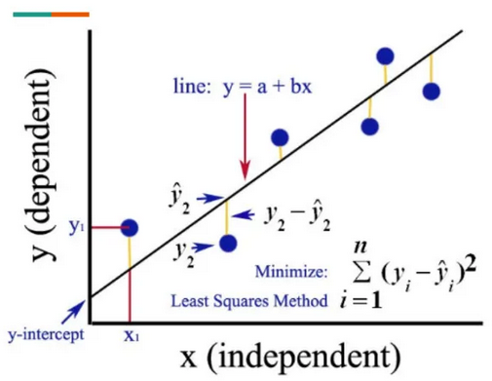
Finding the best fit line
In machine learning, finding the best-fitting line is crucial in linear regression, as it determines the accuracy of the predictions made by the model. The best-fitting line is the line that has the smallest difference between the predicted values and the actual values.
To find the best-fitting line in a linear regression model, one uses a process called “ordinary least squares (OLS) regression”.
This process involves calculating the sum of the squared differences between the predicted values and the actual values for each data point, and then finding the line that minimizes this sum of squared errors.

Slide 19
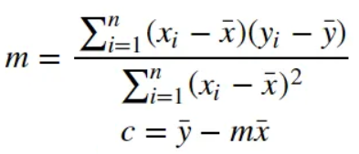
The best-fitting line is found by minimizing the residual sum of squares (RSS), which is the sum of the squared differences between the predicted values and the actual values.
This is achieved by adjusting the values of the intercept and slope coefficients, also known as c and m, respectively.
Once the values of c and m are determined, we can use the linear regression equation to make predictions for new data points. The equation for a simple linear regression model can be written as:
y = c + m * x
Here, y is the dependent variable (the variable we are trying to predict), x is the independent variable (the predictor or feature), c is the intercept term (the value of y when x is zero), and m is the slope coefficient (the change in y for a unit change in x).

Slide 20

Cost function
The cost function, also known as the loss function or objective function, is a measure of how well the model is performing. In linear regression, the cost function is used to calculate the difference between the predicted values and the actual values, also known as the residuals or errors.
The goal of linear regression is to minimize the cost function, which is achieved by finding the best-fitting line that minimizes the sum of the squared differences between the predicted values and the actual values. The most commonly used cost function in linear regression is the Mean Squared Error (MSE), which is calculated as the average of the squared differences between the predicted and actual values:
* Here, n is the number of data points, y_{i} is the actual value, and ŷ_{i} is the predicted value.

Slide 21
Model Performance
Model performance in linear regression can be evaluated using various metrics that measure how well the model fits the data and how well it generalizes to new data. Go to next slides for common metrics used in linear regression: ………………………………

Slide 22
Example:
Let, there is a linear regression model that predicts housing prices based on the size of the house. Here, 10 data points with the following actual prices (y) and predicted prices (y_hat):
y = [100, 150, 200, 250, 300, 350, 400, 450, 500, 550]
y_hat = [110, 140, 180, 240, 290, 320, 380, 420, 480, 520]
* y_mean = sum(y) / len(y) = 325
Sum of Squares Regression (SSR):
SSR is calculated by taking the sum of the squared differences between the predicted values and the mean of the dependent variable. It represents the variability in the dependent variable that is explained by the independent variables. Mathematically, it can be expressed as:
SSR = sum((y_hat — y_mean)²) = 28300

Slide 23
2. Sum of Squares Error (SSE):
SSE is calculated by taking the sum of the squared differences between the predicted values and the actual values of the dependent variable. Mathematically, it can be expressed as:
SSE = sum((y — y_hat)²) = 26700
3. Mean Squared Error (MSE):
This metric measures the average squared difference between the predicted and actual values. It is calculated as the sum of squared residuals divided by the number of data points. A lower MSE indicates better performance. Mathematically, it can be expressed as:
MSE = (1/n) * sum((y — y_hat)²) = 2670

Slide 24
4. Root Mean Squared Error (RMSE):
This metric measures the square root of the MSE and is useful for interpreting the errors in the same units as the dependent variable. Mathematically, it can be expressed as:
RMSE = sqrt(MSE) = sqrt(2670) = 51.68
5. Mean Absolute Error (MAE):
This metric measures the average absolute difference between the predicted and actual values. It is less sensitive to outliers than MSE, but still provides a measure of the model’s accuracy. Mathematically, it can be expressed as:
MAE = (1/n) * sum(abs(y — y_hat)) = 36
6. Sum Of Squares Total (SST):
SST is calculated by taking the sum of the squared differences between the actual values of the dependent variable and its mean value. Mathematically, it can be expressed as:
SST = sum((y — y_mean)²) = 55000

Slide 25
R-Squared (R²):
This metric measures the proportion of variance in the dependent variable that is explained by the independent variable(s).
It ranges from 0 to 1, with a higher value indicating better performance.
R² = SSR / SST = 28300 / 55000 = 0.5164
R² = 1 — SSE / SST = 1 —26700 / 55000 = 0.5164

Slide 26
13/11/2024
As one did when studying regression:
let’s begin by thinking about the type of problems are trying to solve.
Here are a few examples of classification tasks:
Predicting whether a given email is spam.
Predicting the type of object in an image.
Predicting whether a manufactured good is defective. The point of classification is hopefully clear: we’re trying to identify the most appropriate class for an input data point.

Slide 27
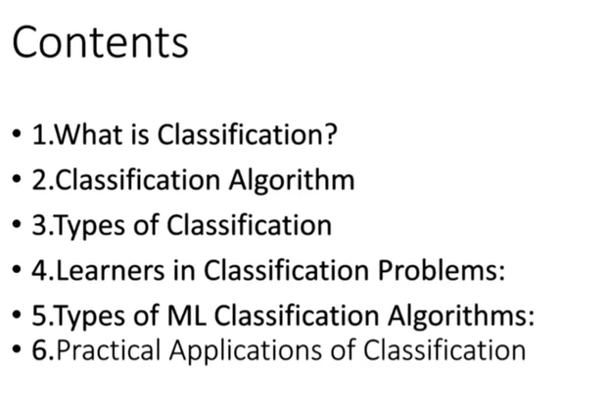

Slide 28
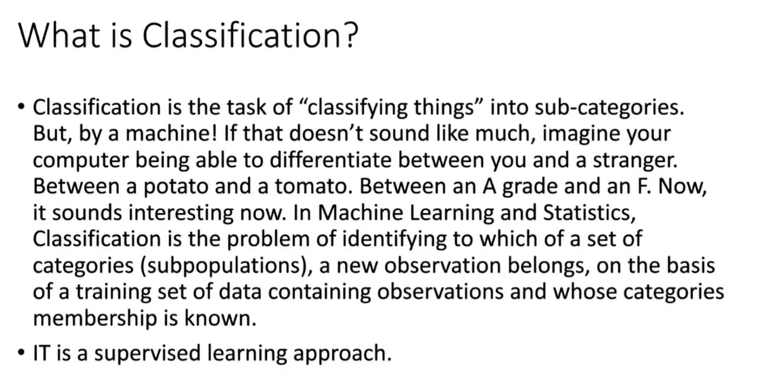

Slide 29
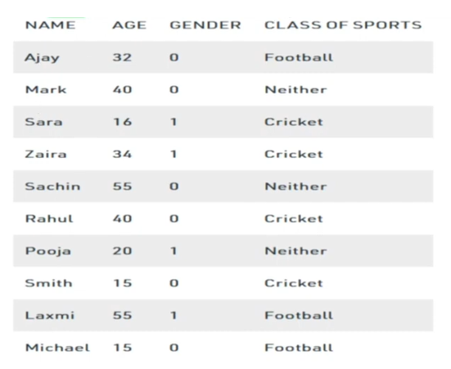
label
If it exists then one can claim it is supervised
If it doesn’t exist then one can claim it is un-supervised

Slide 30
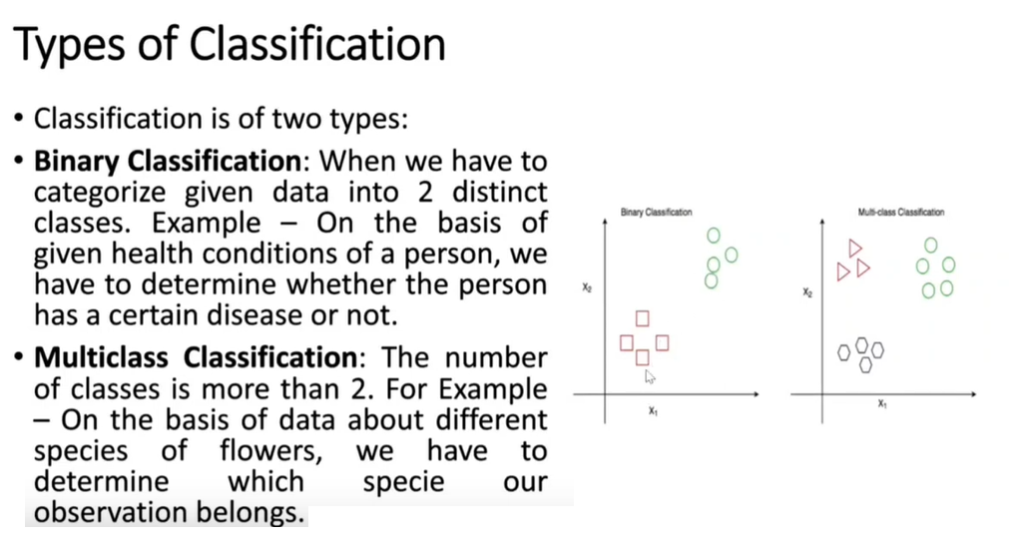

Slide 31
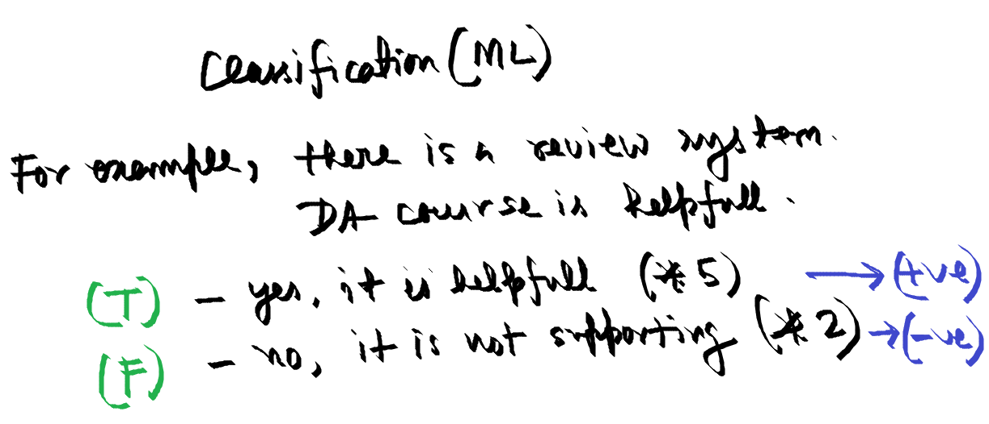

Slide 32
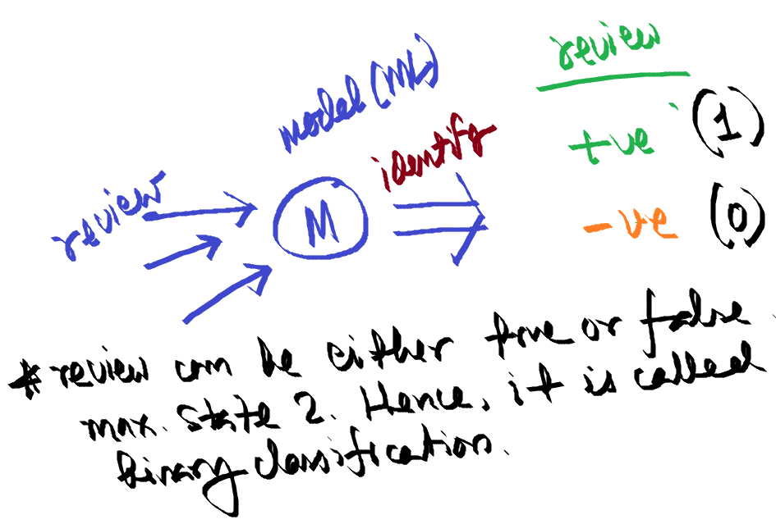
How will one automates the last slide problem?
It needs a MODEL

Slide 33
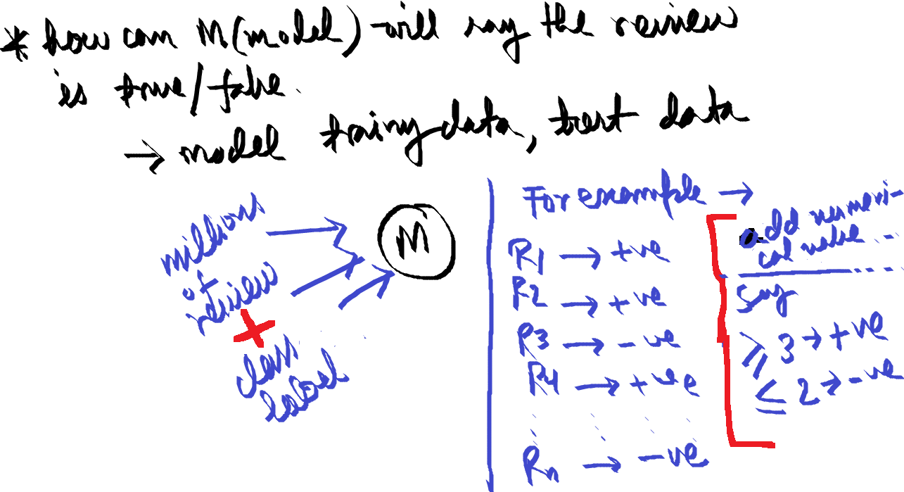

Slide 34
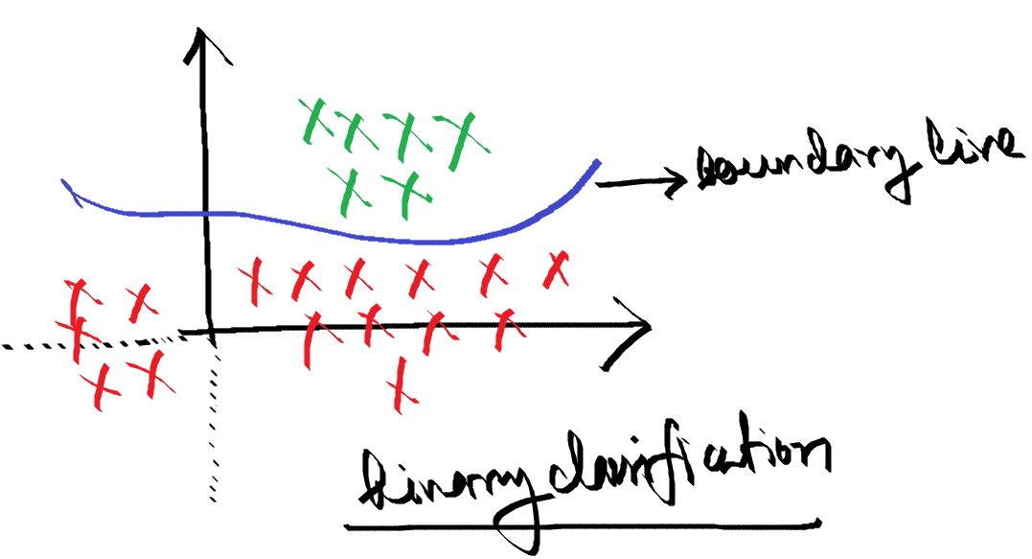

Slide 35
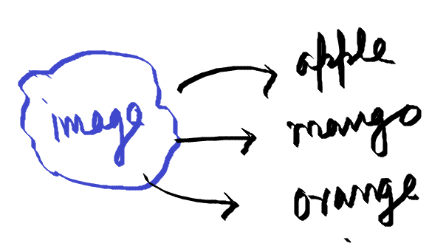
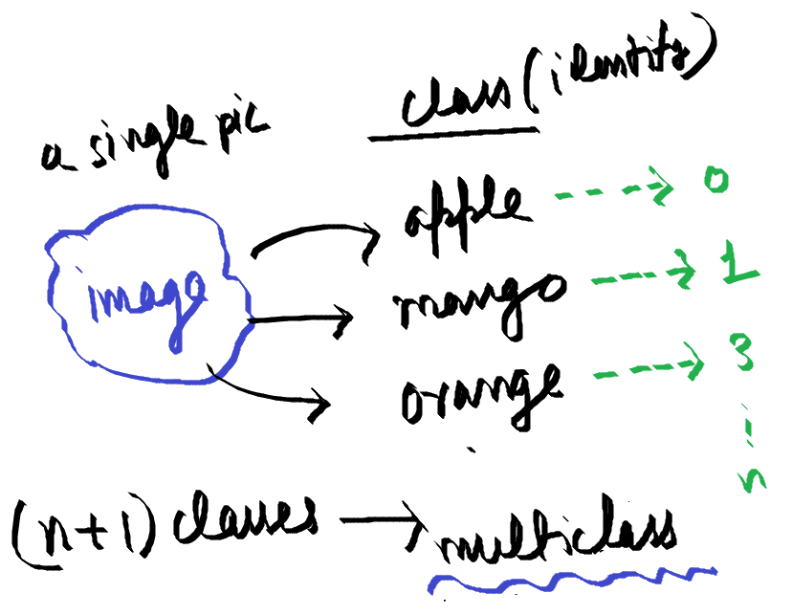
Multiclass Classification

Slide 36
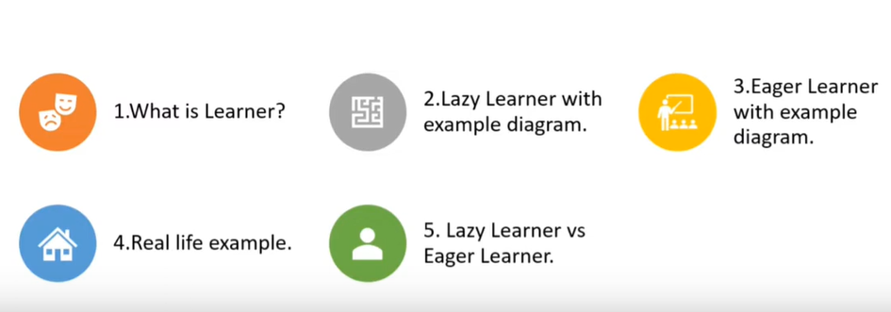

Slide 37
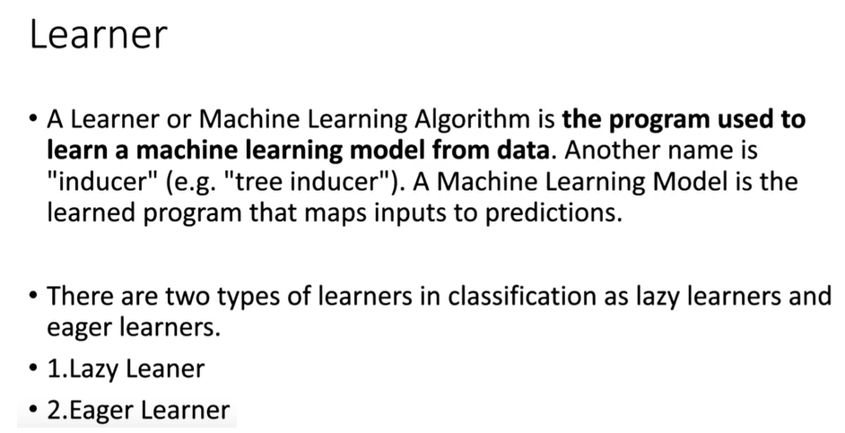
Knowledge

Slide 38
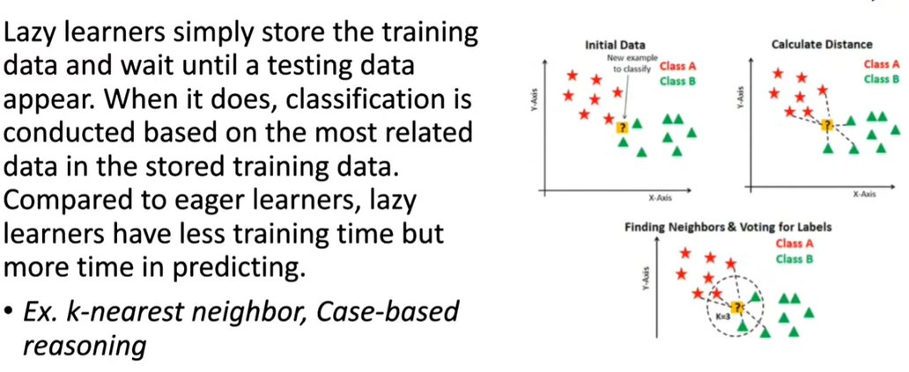
Initially, store data (no activities)
Less training time: take few samples to calculate
More prediction time. Due to distance calculation

Slide 39
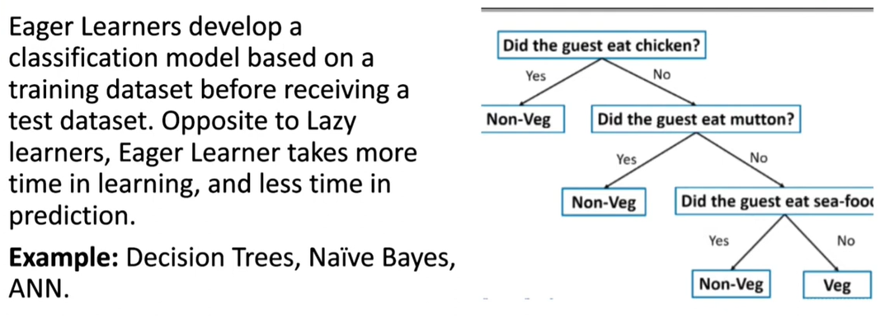
More training time: full data set
less prediction time. Due to created table or tree

Slide 40
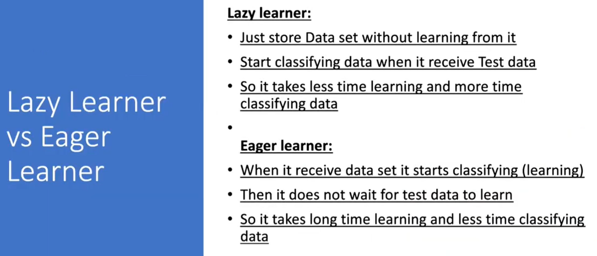

Slide 41
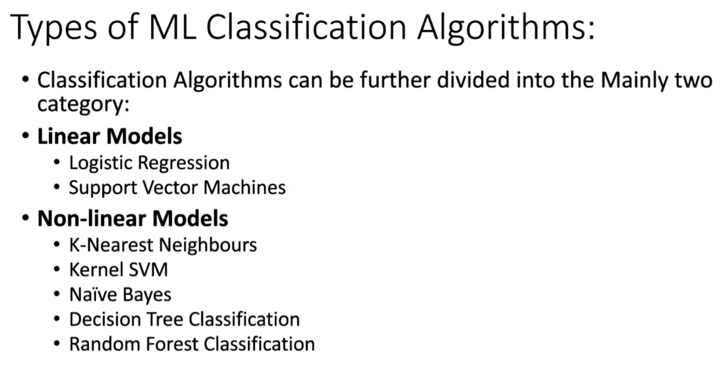
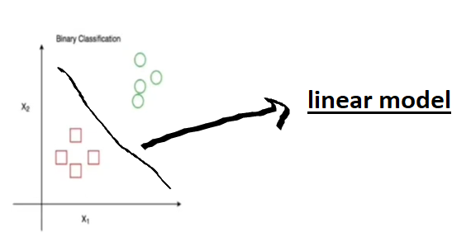

Slide 42
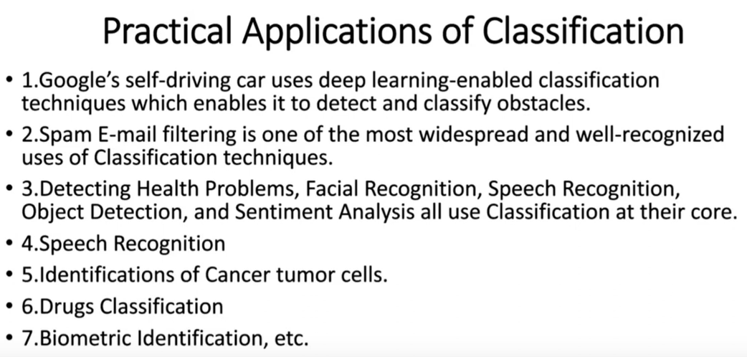

Slide 43
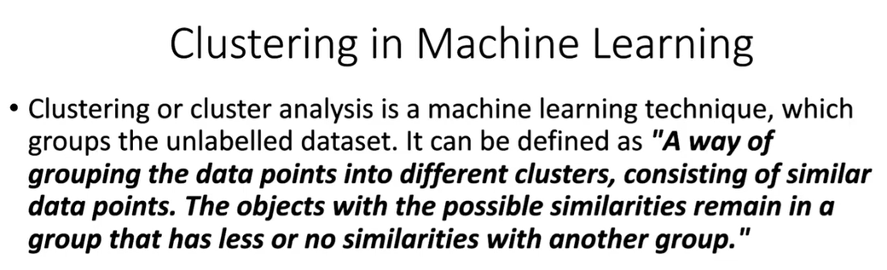


Slide 44
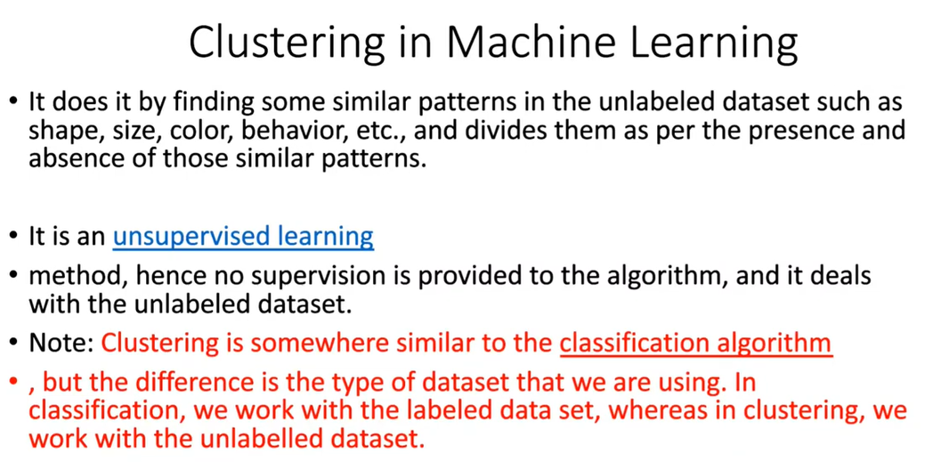

Slide 45
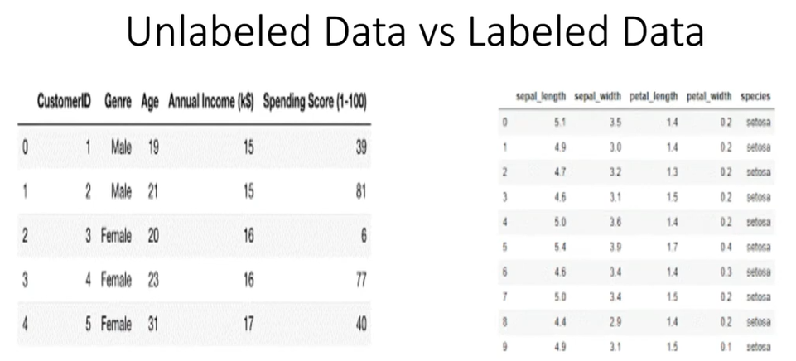

Slide 46
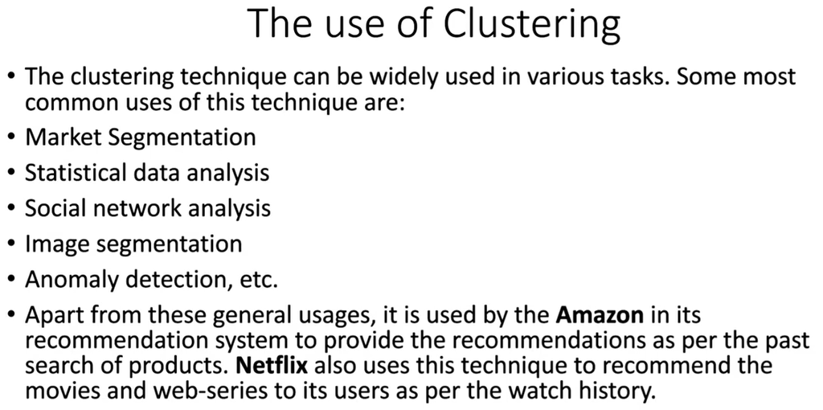

Slide 47
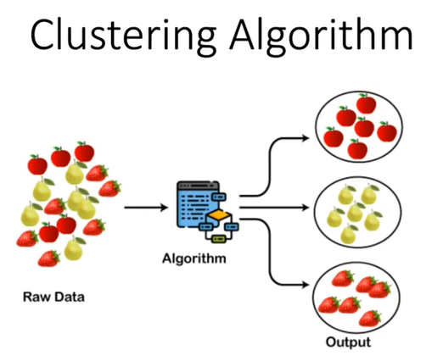
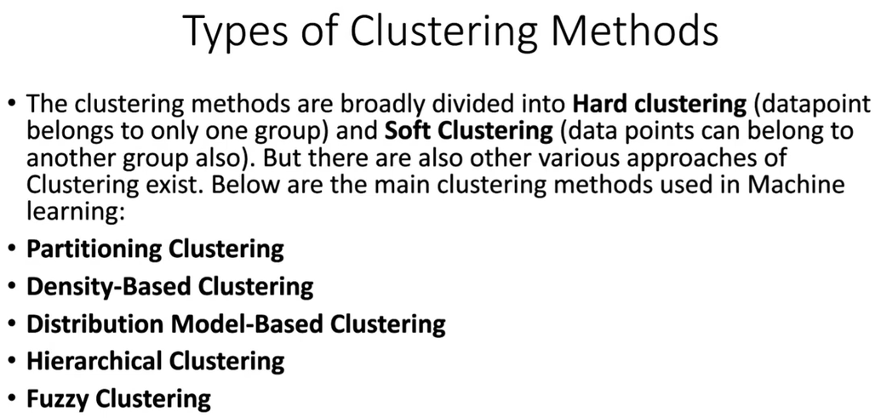

Slide 48
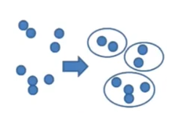

Hard clustering
Soft clustering

Slide 49
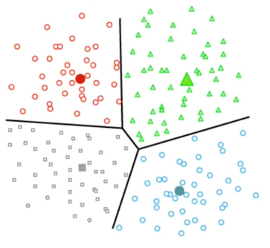
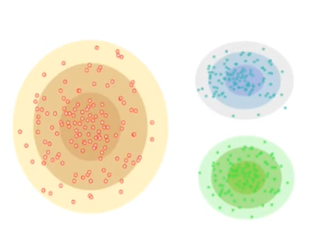
Partitioning clustering
Dense base clustering
Density based clustering
Centered base: properties or objects are
close to center

Slide 50
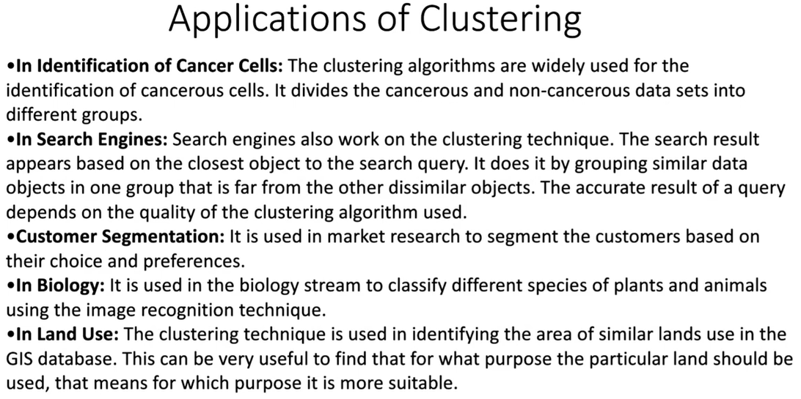

Slide 51
K-means Clustering
18-11-2024
What is clustering? [done]
Why would we want to cluster?
How would you determine clusters?
How can you do this efficiently?

Slide 52
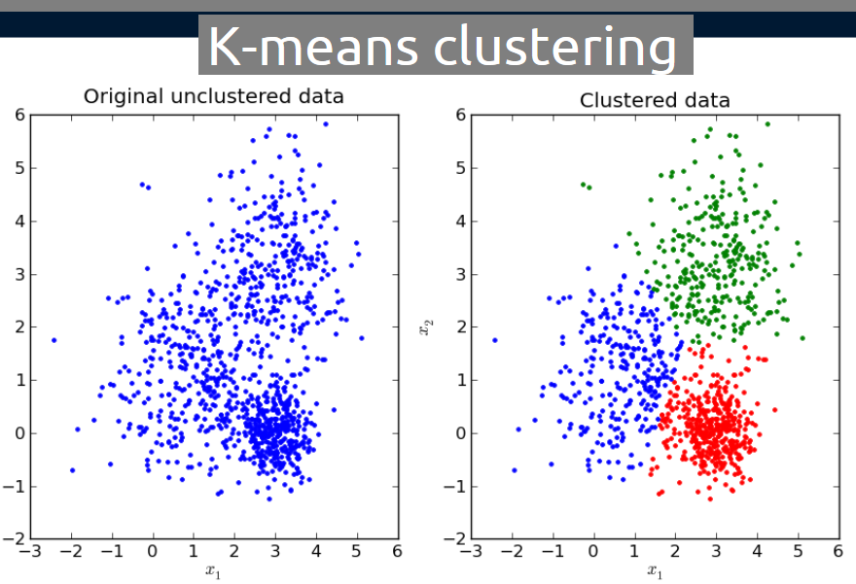

Slide 53
The key objective of a k-means algorithm is to organize data into clusters such that there is high intra-cluster similarity and low inter-cluster similarity.
An item will only belong to one cluster, not several, that is, it generates a specific number of disjoint, non-hierarchical clusters.
K-means uses the strategy of divide and concur, and it is a classic example for an expectation maximization (EM) algorithm.
EM algorithms are made up of two steps:
– The first step is known as expectation(E) and is used to find the expected point associated with a cluster; and
– The second step is known as maximization(M) and is used to improve the estimation of the cluster using knowledge from the first step.

Slide 54
K-means Clustering
Strengths
Simple iterative method
User provides “K”
Weaknesses
Often too simple → bad results
Difficult to guess the correct “K”

Slide 55
K-means Clustering
Basic Algorithm:
Step 0: select K
Step 1: randomly select initial cluster seeds
Seed 1 650
Seed 2 200

Slide 56
K-means Clustering
An initial cluster seed represents the “mean value” of its cluster.
In the preceding figure:
Cluster seed 1 = 650
Cluster seed 2 = 200

Slide 57
K-means Clustering
Step 2: calculate distance from each object to each cluster seed.
What type of distance should we use?
Squared Euclidean distance
Step 3: Assign each object to the closest cluster

Slide 58
K-means Clustering
Seed 1
Seed 2

Slide 59
K-means Clustering
Step 4: Compute the new centroid for each cluster
Cluster Seed 1 708.9
Cluster Seed 2 214.2

Slide 60
K-means Clustering
Iterate:
Calculate distance from objects to cluster centroids.
Assign objects to closest cluster
Recalculate new centroids
Stop based on convergence criteria
No change in clusters
Max iterations

Slide 61
K-means Issues
Distance measure is squared Euclidean
Scale should be similar in all dimensions
Rescale data?
Not good for nominal data. Why?
Approach tries to minimize the within-cluster sum of squares error (WCSS)
Implicit assumption that SSE is similar for each group

Slide 62
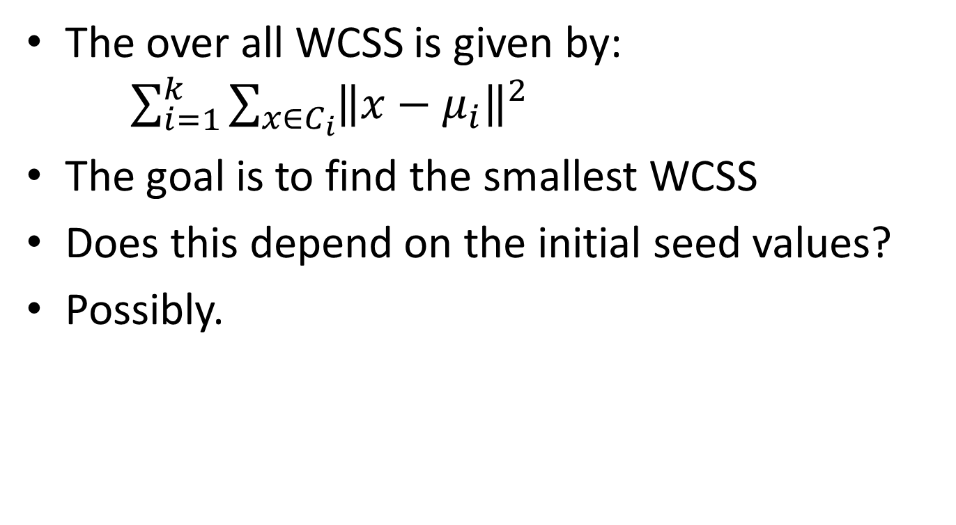
WCSS
The over all WCSS is given by: $\sum_{i=1}^{k}{\sum_{x∈C_{i}}{{\left\|x−μ_{i}\right\|}^{2}}}$
The goal is to find the smallest WCSS
Does this depend on the initial seed values?
Possibly.

Slide 63
Bottom Line
K-means
Easy to use
Need to know K
May need to scale data
Good initial method
Local optima
No guarantee of optimal solution
Repeat with different starting values

Slide 64


Slide 65
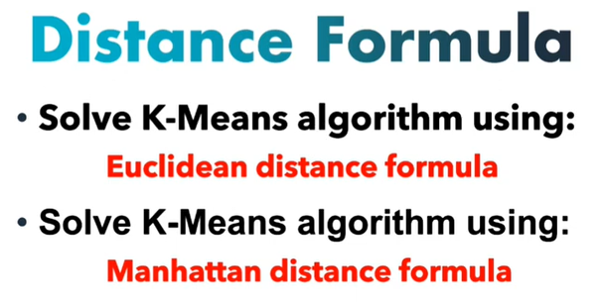
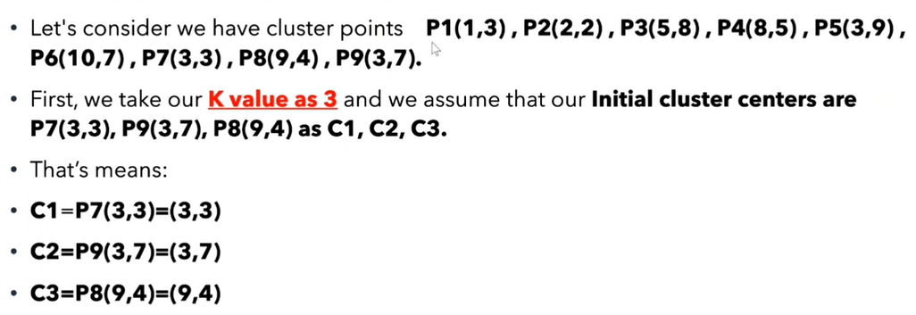
Randomly chosen

Slide 66
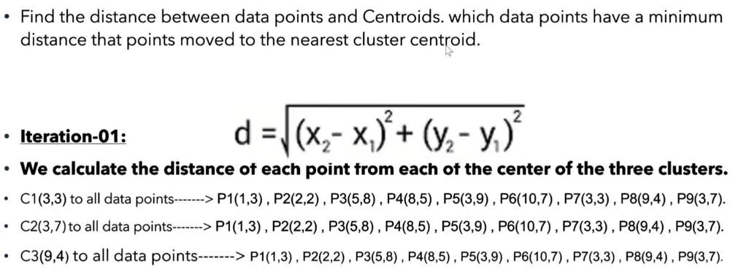

Slide 67
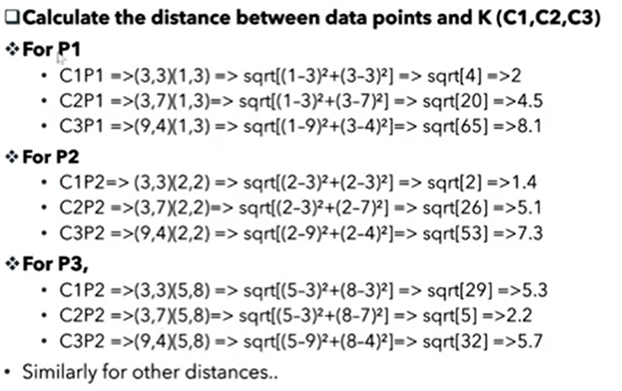

Slide 68
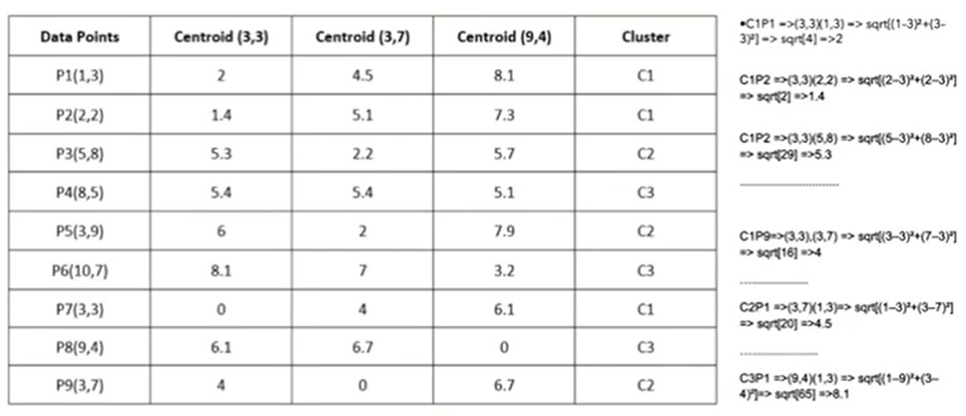
Iteration 1

Slide 69
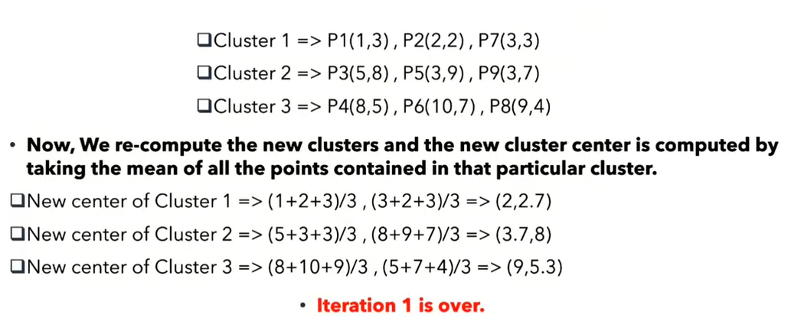
Iteration 1, step-1

Slide 70
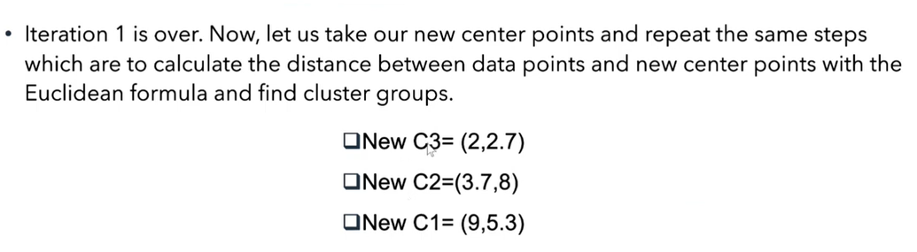
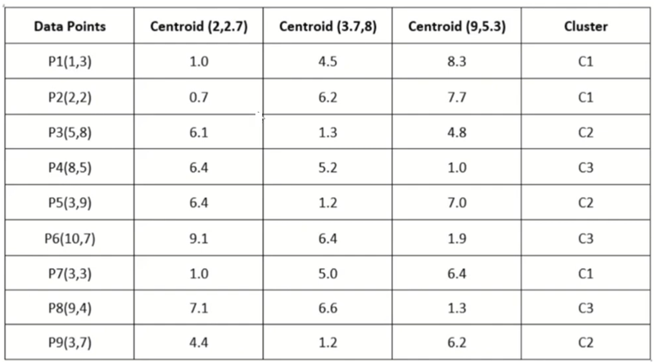
Iteration 2

Slide 71
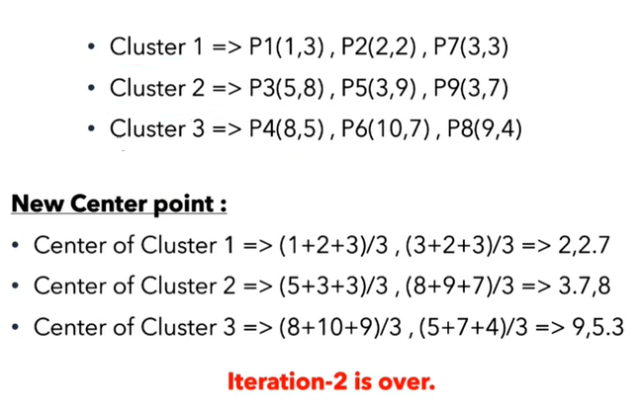
Iteration 2, step-2

Slide 72

Last step

Slide 73

Answer

Slide 74


Slide 75


Slide 76



Slide 77


Slide 78


Slide 79


Slide 80


Slide 81


Slide 82


Slide 83


Slide 84


Slide 85



Slide 86


Slide 87


Slide 88


Slide 89


Slide 90


Slide 91


Slide 92



Slide 93


Slide 94


Slide 95


Slide 96


Slide 97

Example-2
date. 20/11/2024
Lily age 5, find out her class when k = 3

Slide 98


Here male is denoted by 0 and female is 1. Lily’s age 5 and gender female. (note. K = 3) lily (x₂, y₂): lily (5, 1) * rest of the data-set subtract from the lily for finding distance.

Slide 99


k = 3, so we will sort according to the least distance and then take the voting power for 3.

Slide 100

Difference between K-means and KNN algorithm

Slide 101

Choosing reason of K-means and KNN

Slide 102


Slide 103


Slide 104

K-means and KNN ?

Slide 105

K-means and KNN ?

Slide 106

K-means and KNN ?

Slide 107


Slide 108

(feature data) Vectori-zed
hyperplane

Slide 109


Slide 110



Slide 111




Slide 112


1
2

Slide 113

S-1
Support vector
Support vector

Slide 114

5
Total Support vector = ?

Slide 115


